Slide 1
CEF 44O: INTERNET PROGRAMMING (J2EE) AND MOBILE PROGRAMMING
PRESENTED BY
AJAMAH GODLOVE NKEMEJAH FE21A129
AMABO JOSHUA NGWA FE21A135
MBACHAM LOANA NING FE21A228
NGOUNG TASSA ALAIN SHIRESS FE21A262
NYUYSEVER BORIS DINNYUY FE21A295
TASK 4

Slide 2
TABLE OF CONTENTS
01
02
03
04
05
06
INTRODUCTION
USE CASE ANALYSIS & DESIGN
CLASS DIAGRAM AND DESIGN
SEQUENCE DIAGRAM
CONTEXT DIAGRAM
DEPLOYMENT DIAGRAM & DESIGN
CONCLUSION

Slide 3
01. INTRODUCTION
A. FOREWORD
In todays fast pace technological landscape, business and organizations rely on robust systems to streamline their operations and enhance productivity.
System modelling and design is the process of creating a blueprint that that captures structures, behavior and functionality of systems allowing analysis, simulation and optimization of complex systems.

Slide 4
B. RELATION TO SCOPE
In relation to the fingerprint-based attendance recording system, this cutting-edge solution leverages biometric technology to accurately record and track the attendance of individuals by meticulously expatiating on architectural designs and workflows as well as ensuring seamless integration with existing infrastructure.
The boons are thus optimization of recording process, elimination of manual errors and overall enhancement in security just to name a few.

Slide 5
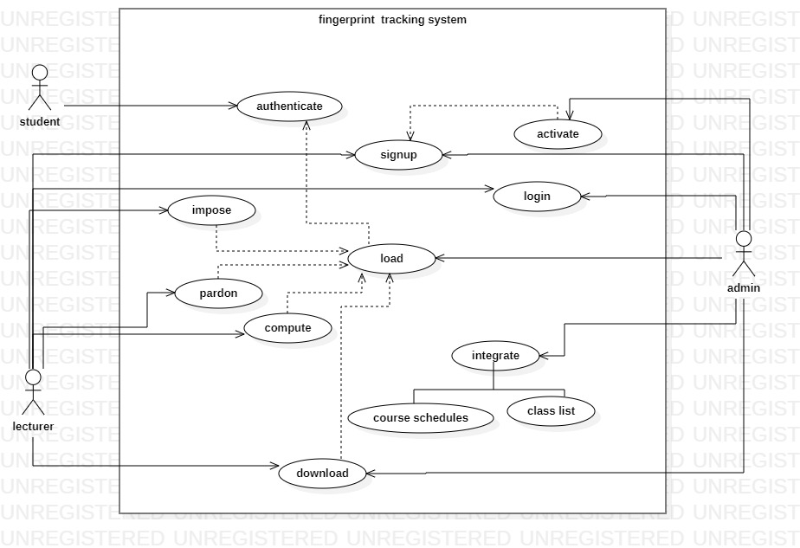
02. USE CASE ANALYSIS & DESIGN
This explains how users interact with a digital product of system by outlining the flow of
user inputs, establishing successful and failed paths to meeting goals thus allowing better
understanding of why errors occur

Slide 6
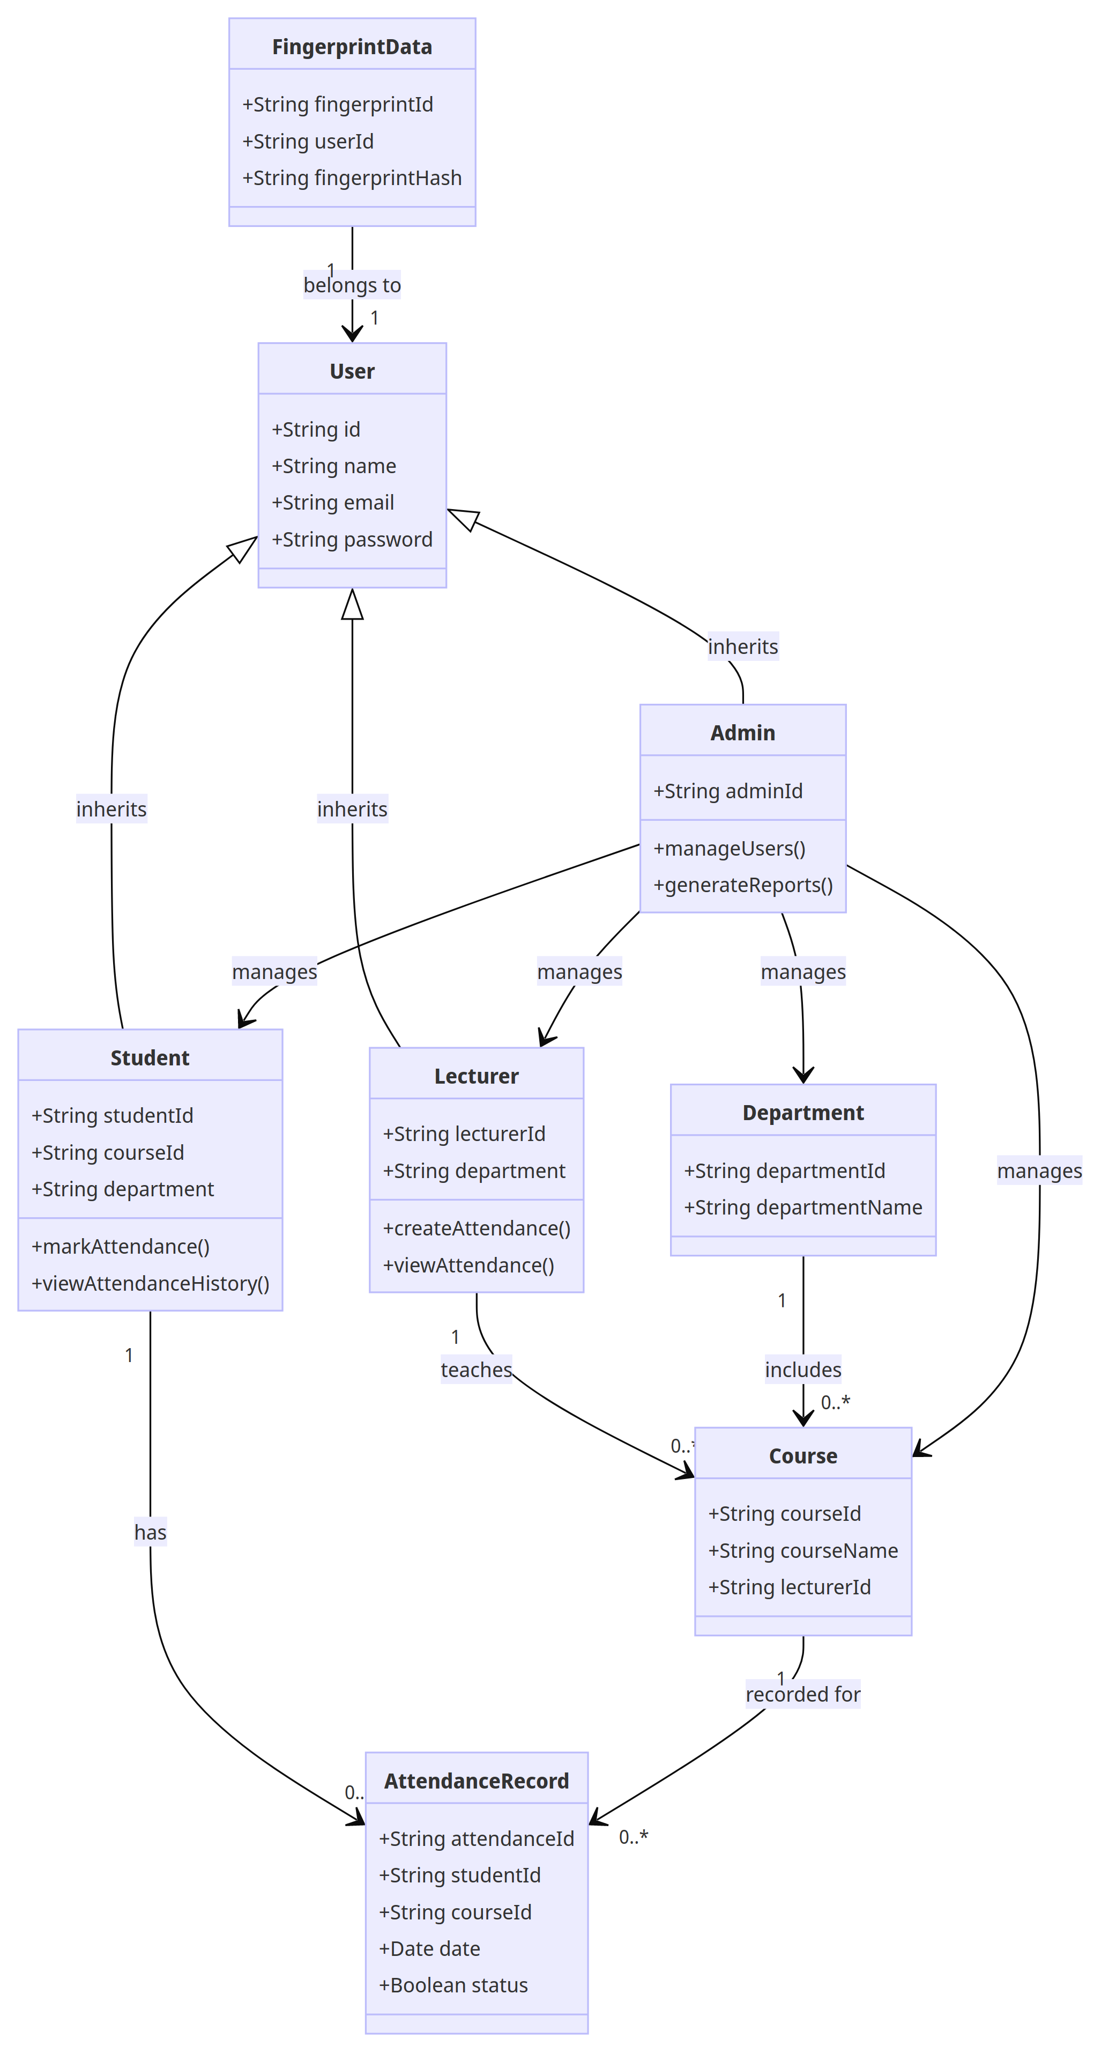
03. CLASS DIAGRAM & DESIGN
Class diagrams model the objects that make up the system, displaying inter-object relationship
and what said objects do and provide as services

Slide 7
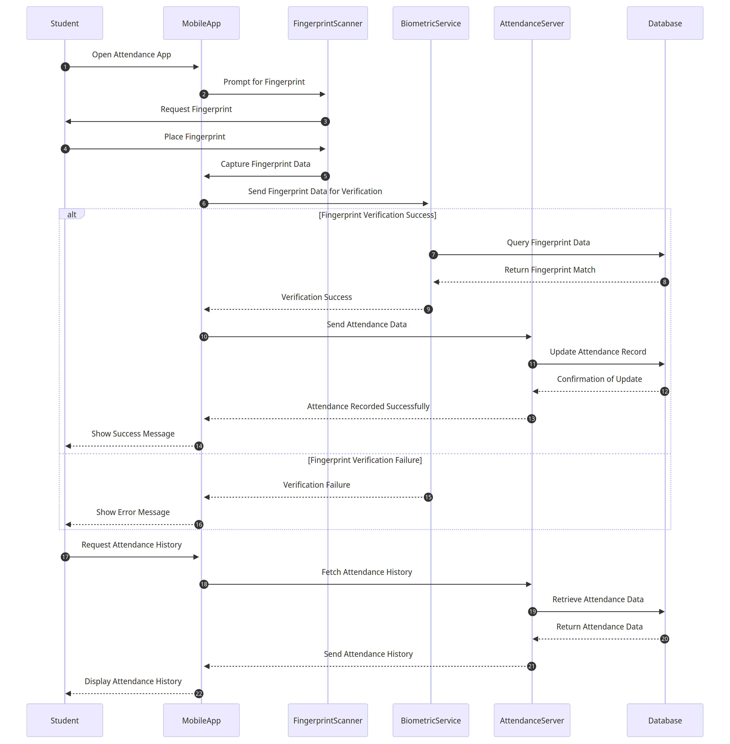
04. SEQUENCE DIAGRAM
This diagram specifies the interaction between objects as well as message flows across the life line. The sequence diagram of our target system outlines the process flow for a biometric (fingerprint) school attendance mobile app.

Slide 8
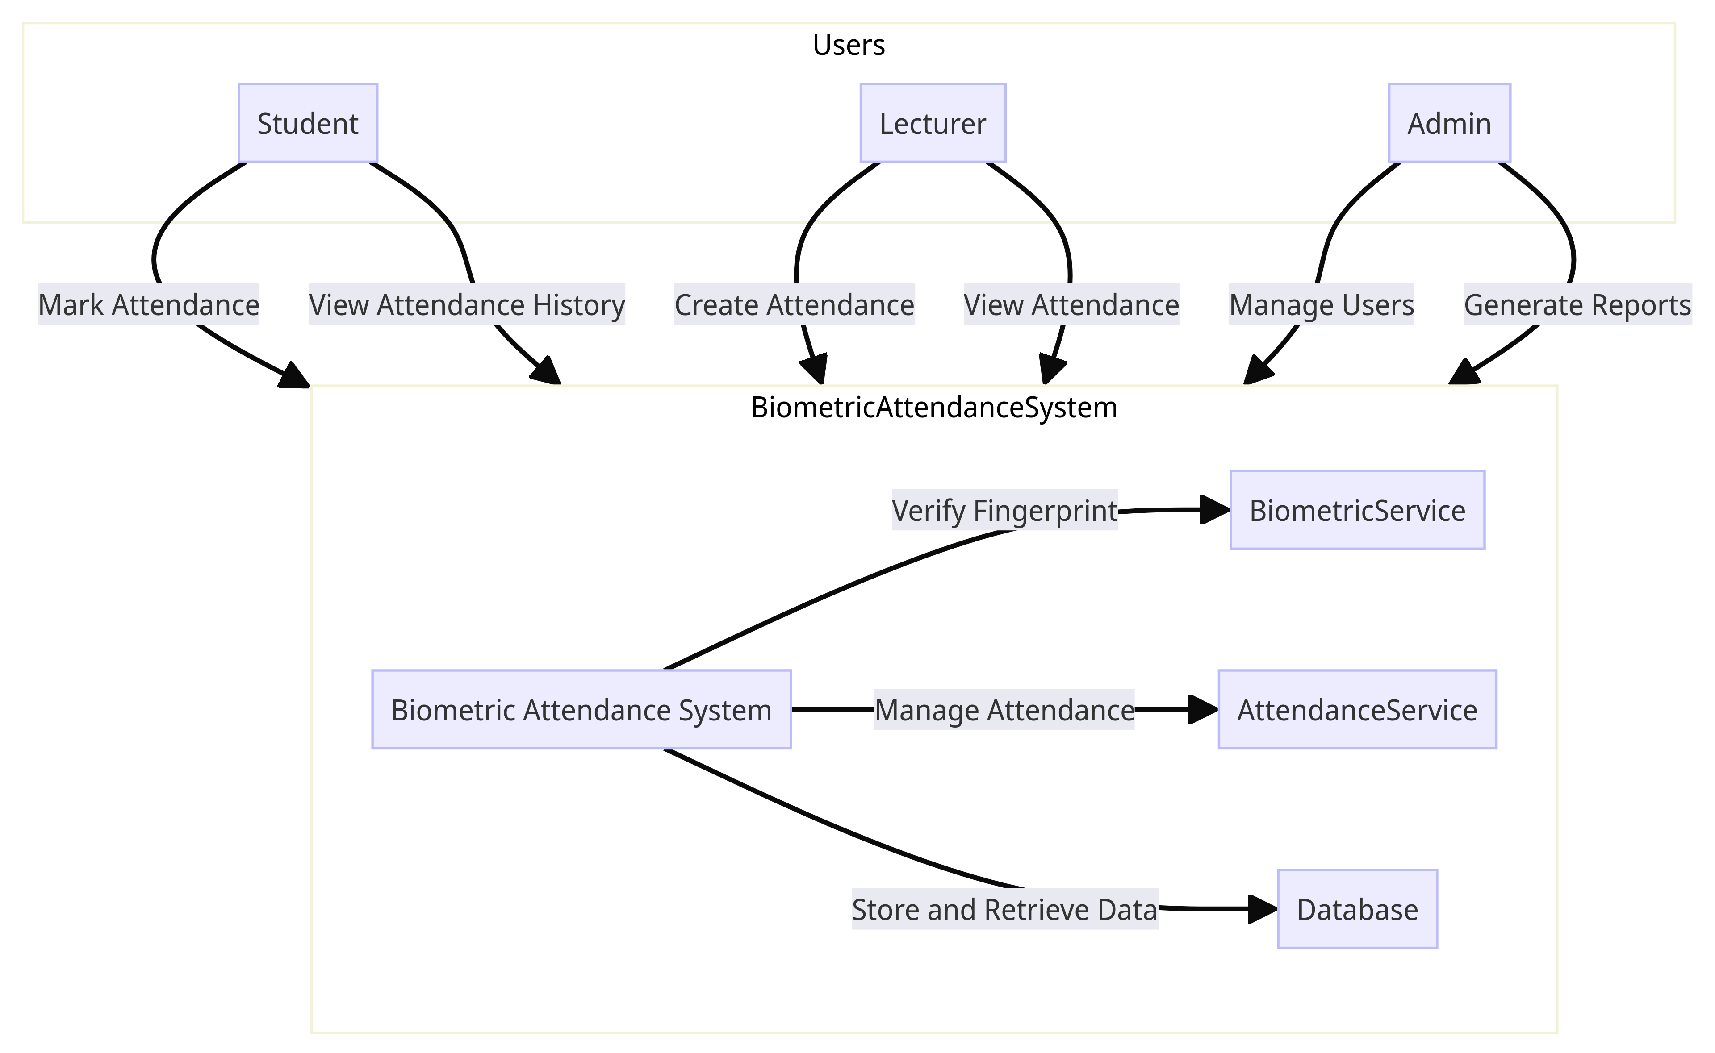
05. CONTEXT DIAGRAM & DESIGN
A context diagram, also known as a context-level data flow diagram (DFD), is a visual representation that illustrates the interactions between a system or software application and its external entities by providing a high-level overview of the system's boundaries; showing how it interacts with external entities, processes, and data flows

Slide 9
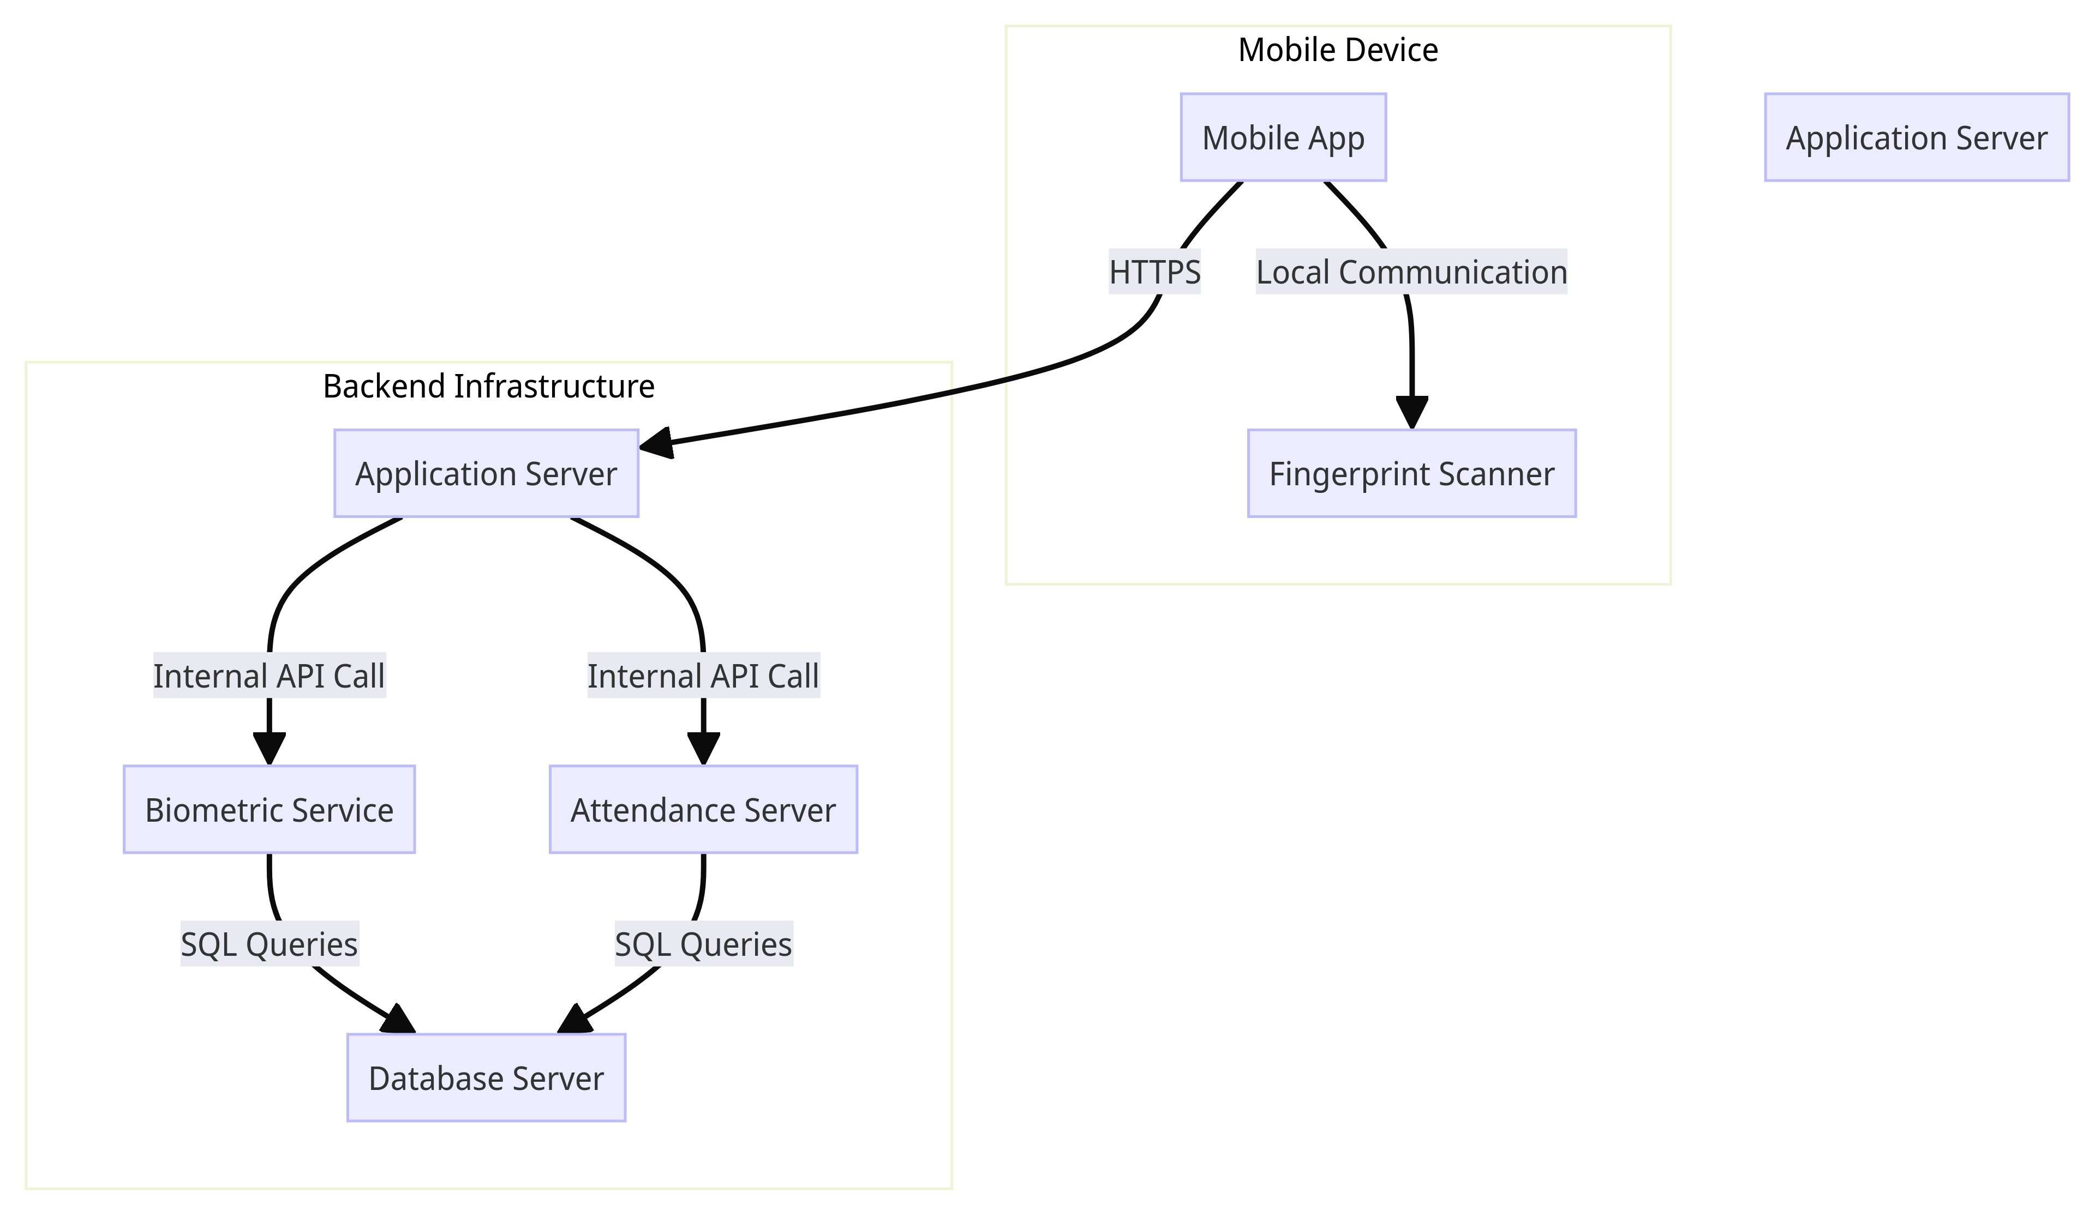
06. DEPLOYMENT DIAGRAM & DESIGN
The deployment diagram is used to visualize the topology of the physical components of the system where the software components are deployed

Slide 10
CONCLUSION
To conclude this, we observe that correct and detailed modelling of the system greatly improves development as the main picture becomes clearer. Modularity is also an advantage of system modelling and design due to splitting of the system to understandable subs and hence, exploiting the functional, non-functional and technical requirements observed in the requirement gathering and analysis phases.

Slide 11
THANKS FOR YOUR KEEN ATTENTION

